Slide 1
Edge API Lifecycle and Tools
Maven Deploy Plugin

Slide 2
Prerequisites
Java
Maven
Use of Maven in CI tooling
Notes:
Candidates need to understand these topics at a high level to go forward. Introduce if somebody doesn’t know already.

Slide 3
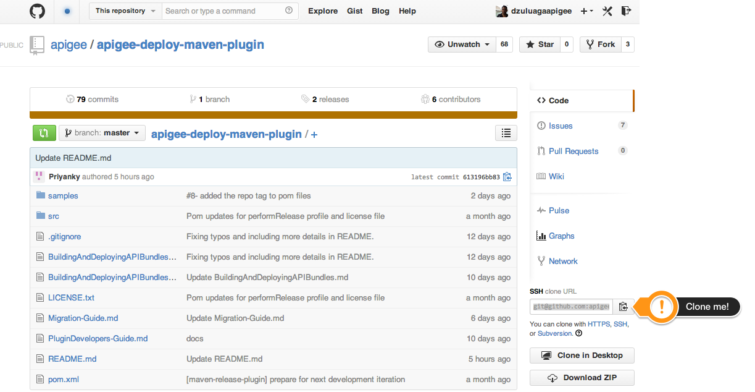
Download Maven Plugin Artifacts
Get samples first by cloning this repo
https://github.com/apigee/apigee-deploy-maven-plugin
Notes:
VINIT

Slide 4
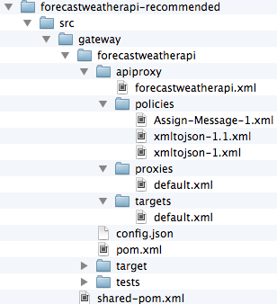
Structure Your Offline Code
Project Workspace
API Proxy Workspace
API Proxy Code
sss
API Proxy core
API Proxy Config
Local Maven Pom File
Jmeter Tests
Maven Parent Pom
Notes:
API Bundle represents the API Proxy to be deployed to the gateway
Examples:
src/gateway/ to contain multiple bundles

Slide 5
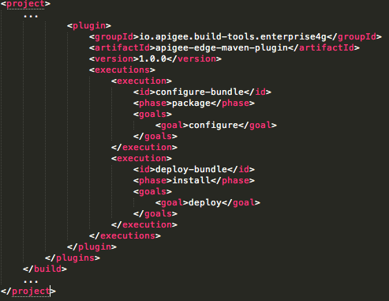
Maven Plugin Components – Parent POM
The maven parent pom file (shared-pom.xml) contains the maven configuration that can be used across all Apigee Edge API proxies.
Location: src/gateway
Contains common dependencies across all bundles
Enables common behavior through inheritance
Plugin coordinates
1.0.1
Phase
Goal
Phase
Goal
Notes:
Location under
Shared-pom.xml or parent pom.xml
Explain how maven downloads plugins from public Maven repositories using plugin coordinates
Maven Central,
GroupId
Based on artifactId
VersionID
No need for private repositories and credentials in settings.xml
Explain inheritance
Benefits
Since common goals are specified at parent pom, there’s no need to specify them again at the pom.xml level – so, you can avoid duplicating plugins across 20 or 40 or whatever number of pom.xmls defined per API
It also allows overriding any configuration if the behavior specified at the parent level does not apply at the child level

Slide 6
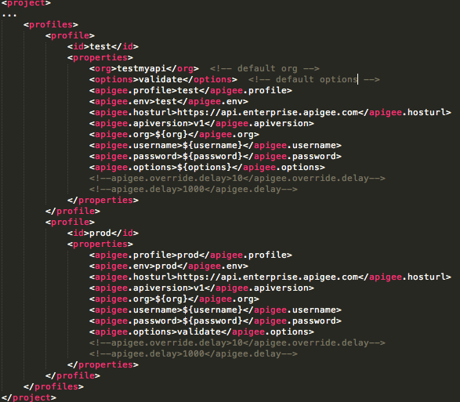
Maven Profiles Configuration – Parent POM
Also in the maven parent pom file (shared-pom.xml), you should include Apigee Edge organization and environment configurations as these are common to all APIs. These are defined using maven profiles.
Notes:
Profiles
Profiles are meant to address configuration changes between environments e.g.Test and Prod environments most likely run
Defaul hosturl:
The current value is valid for Apigee Cloud Environment. For on premise environments this value should be modified with your hostname

Slide 7
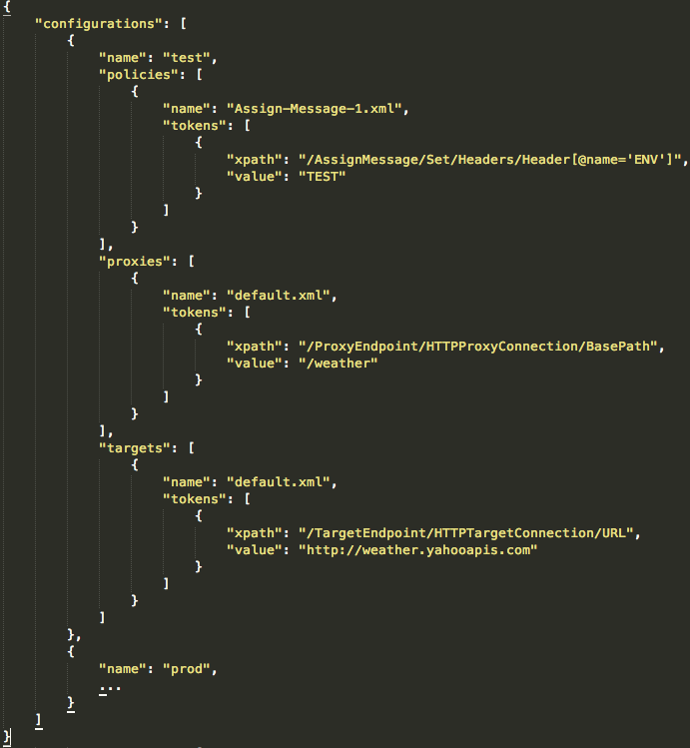
Applying API Proxy Configs w/ config.json
Top level array is apigee.profile from parent POM
Policies mapped in an array – each is an object
Tokens hold elements to apply configuration
Xpath used for search and replace
Notes:
Full support of Xpath see Header[@name=ENV] search expression
Security:
- No keys, no secrets
- Use KVM instead if MD5 verification is required. So the same file signature matches
Do:
- Reassign targets
-

Slide 8
Executing Maven Deploy
Using the default apigee.option configuration “validate” creates new revision in Apigee Edge when executing the maven command to build/deploy the API proxy.
mvn install -Ptest -Dusername=$ae_username -Dpassword=$ae_password -Dorg=testmyapi
Notes:
Demo with no skipTests arguments
Notice passing username and password as environment variables. You don’t want to expose your credentials storing them in you source control repository
Notice I passed –Dorg=testmyapi, in case you want to target an organization different than the default one specified in pom.xml
Config.json to be explained in the next steps
Tests with Jmeter to be explained in the next steps

Slide 9
Getting Started – Apigee Maven Plugin
Other useful maven command options:
Skips tests -DskipTests=true
Overrides current revision -Doptions=validate,update
Deletes currently deployed bundle -Doptions=clean
Imports without deploying -Doptions=inactive
Packages bundle mvn package -Ptest
Runs JMeter Tests mvn jmeter:jmeter -Ptest -Dusername=$ae_username -Dpassword=$ae_password -Dorg=testmyapi -DtestData=weather_test.csv -DthreadNum=5 -DrampUpPeriodSecs=5 -DloopCount=2
Notes:
Demo with no skipTests arguments
Notice passing username and password as environment variables. You don’t want to expose your credentials storing them in you source control repository
Notice I passed –Dorg=testmyapi, in case you want to target an organization different than the default one specified in pom.xml
Config.json to be explained in the next steps
Tests with Jmeter to be explained in the next steps

Slide 10
THANK YOU

